Slide 1

Using an outcome tree to display outcomes for two events
Task A: Outcome trees for two-stage trials
1) This spinner will be spun once.
Complete the outcome tree for this single-stage trial.
2) Spinners 1 and 2 will be spun once each.
B
A
Z
X
Y
E
A
spinner 1
spinner 2
D
B
A
a) What do the two branches in the box represent?
b) Complete this outcome tree.
C
A
Y
Z
E
3) Spinner 3 will be spun twice.
a) Complete the outcome tree.
b) Complete the sample space for this outcome tree.
4) Spinners 4 and 5 are spun once each and have these outcomes:
spinner 4 = {A, B}
spinner 5 = {red, blue}
Complete this outcome tree and sample space.
R
P
Q
spinner 3
PQ
QP
P
Q
R
P
Q
R
sample space

Slide 2
Using an outcome tree to display outcomes for two events
5) Spinners 6 and 7 will be spun once each.
Complete the outcome tree from its sample space.
6) Spinners 8 and 9 will be spun once each.
Fill in the outcomes of each spinner from the outcome tree.
T
spinner 8
sample space
G, win
G, lose
G, draw
H, win
H, lose
H, draw
D
D
T
spinner 9
U
D
V
E
Task B: Outcome trees from two events
1) This spinner will be spun once.
a) Complete this outcome tree.
16
1
prime number
11
4
square number
8
6
not a prime number
prime number
not a square number
not a prime number
b) The spinner lands on an 11. Using the outcome tree, which two events have just happened?
‹#›

Slide 3
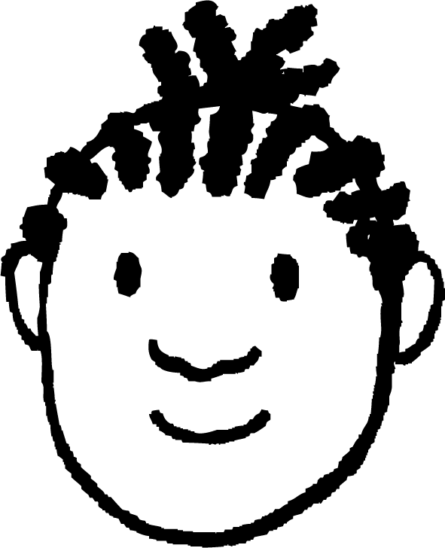

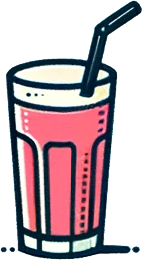
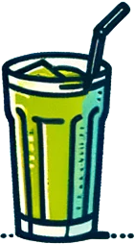
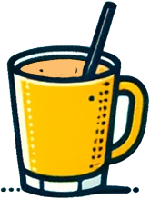
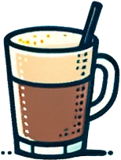

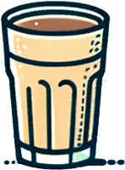
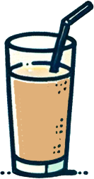
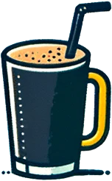
Using an outcome tree to display outcomes for two events
2) A spinner has outcomes of: {5, 9, 15, 25, 28, 441}
Complete this outcome tree.
multiple of 5
not a square number
3) A spinner has outcomes of: {1, 4, 8, 16, 25, 27, 30, 36, 39, 64}.
Jacob is going to spin this spinner and looks for the events of landing on a square number that is also a cube number.
Jacob
a) Draw and complete an outcome tree for this trial.
b) How many outcomes match the events that Jacob is looking out for?
4) In a cafe they have the following drinks on the menu.
a) Create an outcome tree with the first event being “has a handle” and the second “has a straw”.
A
B
C
D
E
F
G
H
I
b) On your tree circle the outcomes that represent straw but no handle.
Mathematics in Education and Industry
v2.3

